Slide 1
New set of figures as of feb 2025

Slide 2
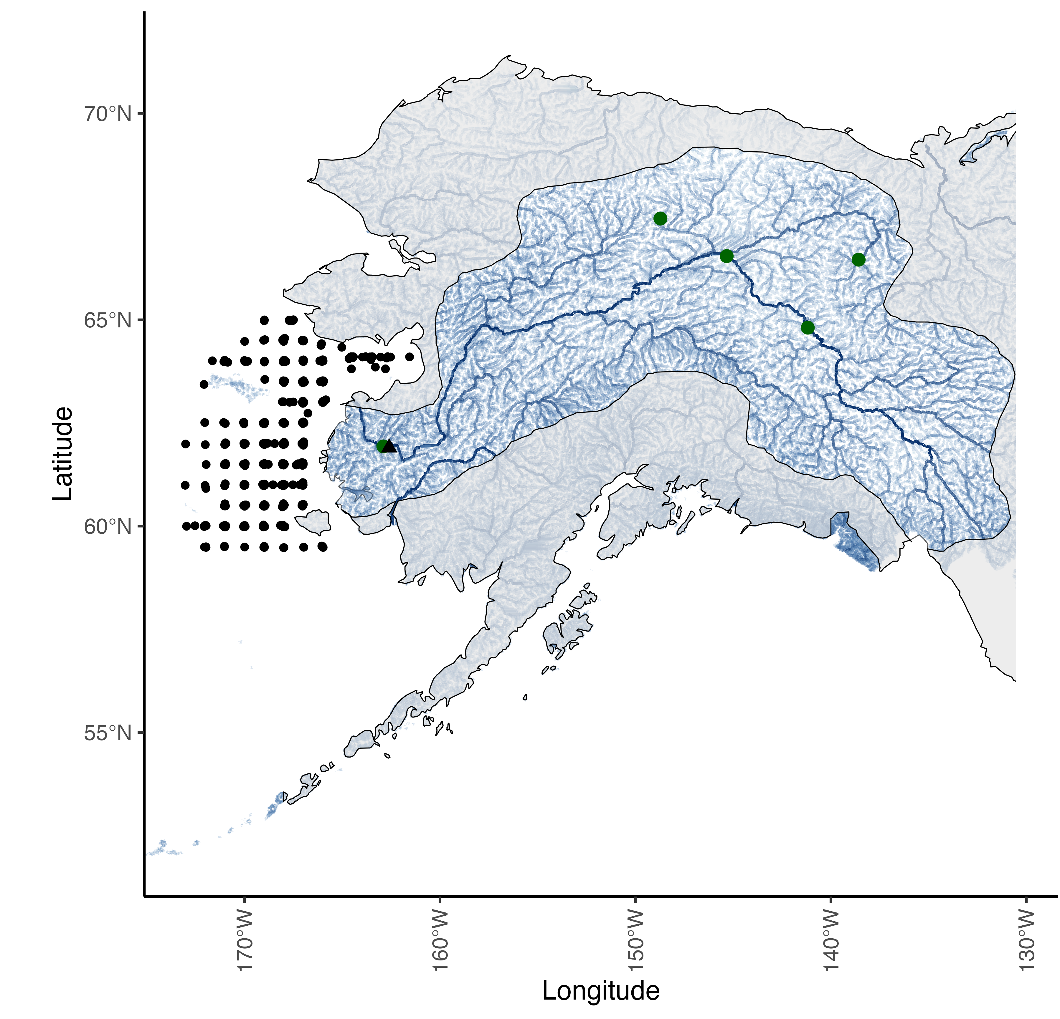
Notes:
Figure 1: Map of the Yukon River watershed, which includes Alaska, USA, and western Canada. The mask is highlighting the Yukon River watershed and associated tributaries, the mainstem of the Yukon River is the most prominent dark blue line and the green dots represent ADFG escapement project locations that were used as data in the Fall chum salmon run reconstruction. The black triangle represents Pilot Station, AK, the source of the USGS flow measurement station for the Yukon mainstem. The black gridded points represent survey stations for the NBS survey that collected information for the juvenile index and the stomach fullness index used in the IPM.
---- try to add box for region temperatures are extracted from

Slide 3
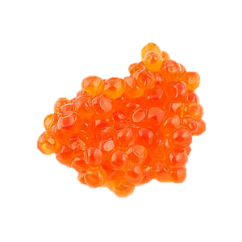
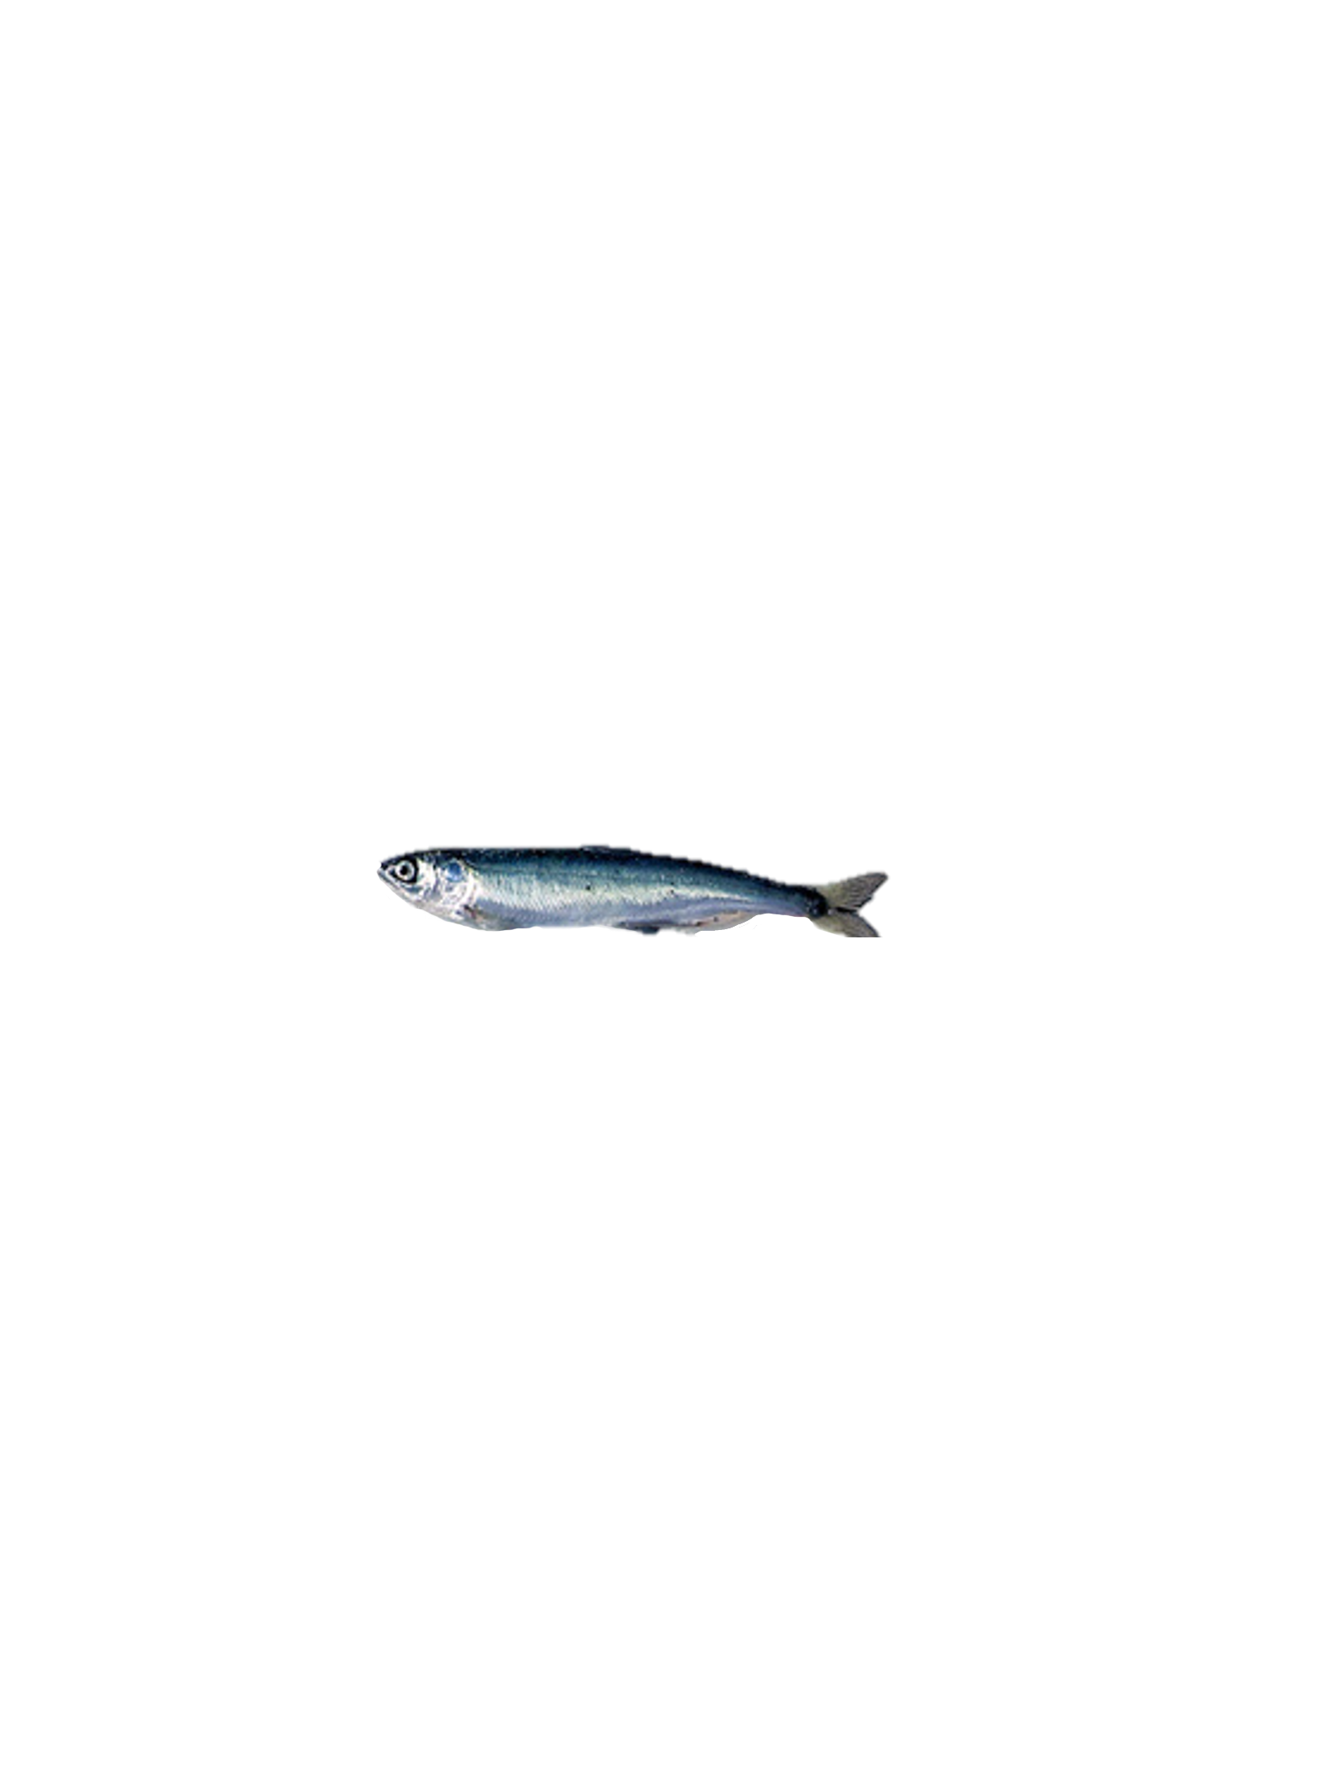
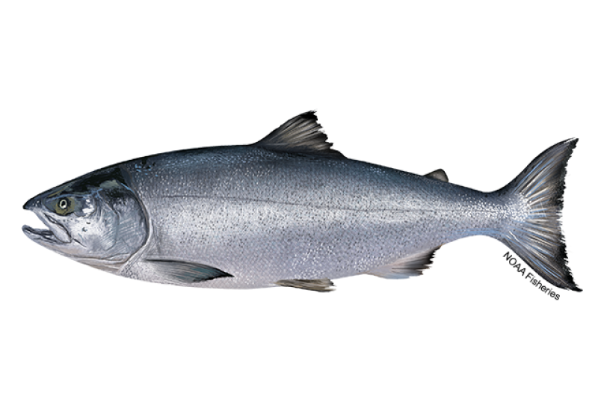
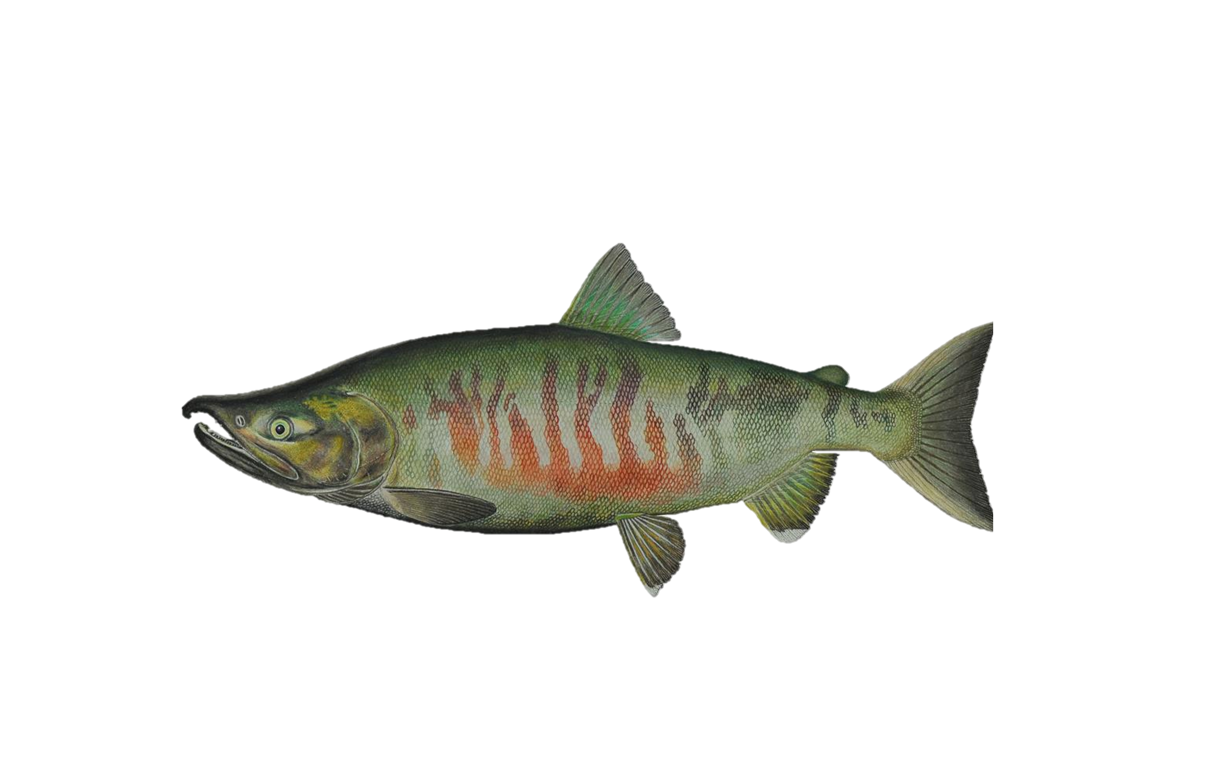
Fall Chum Integrated Population Model Structure
1.N_{t,s=e}
Egg Abundance
Juvenile Survival Covariates (Stage 1-2)
1. Mean Spawner Size
ADFG Age Sex Length Database, Oke et al 2020
2. Fall Snow Depth
Alaska Climate Research Center, Circle, AK – Figure 1
3. Yukon river mainstem flow rate
USGS, Pilot Station – Figure 1
4. N Bering Sea Summer Cumulative Degree Days
AKFIN, NOAA -– Figure 1
5. EBS Pollock Recruitment Index
Ianelli et al. 2024
2. N_{t+1,s=j}
Abundance end of first summer at sea
Northern Bering Sea surveys (Figure 1)
NOAA/ADFG, Modeled Index: Cunningham et al.)
3. N_{t+a+1,s=m,a}
Abundance after first
winter at sea
Marine Survival Covariates (Stage 2-3)
4. N_{t+a+1,s=r,a}
Total Return Abundance
ADFG, Fleischman & Borba 2009
6. Pink hatchery salmon abundance
North Pacific Anadromous Fish Commission
7. Chum hatchery salmon abundance
North Pacific Anadromous Fish Commission
8. Stomach Fullness Index
NOAA, ADFG, NBS Surveys
9. Aleutian Cumulative Degree Days during 1st winter
AKFIN, NOAA
5. N_{t+a+1,s=h,a}
Terminal Harvest abundance
ADFG, Fleischman & Borba 2009
Spawning
6. N_{t+a+1,s=s,a}
Spawner Abundance
ADFG, Fleischman & Borba 2009
Notes:
Figure 2: Schematic illustration of the Yukon River Fall Chum integrated population model, observational data and covariates included when estimating covariate effects on survival for respective life stages. Stages included in the model likelihood are numbered in orange, and the source of the data is included below the stage name. Covariates used to estimate survival included on the boxes on right hand side, orange indicates covariates included in the egg to juvenile abundance at the end of first summer stage (1- 2) and blue indicates covariates included in the juvenile abundance at the end of first summer stage to after the first winter at sea (2 - 3). Data sources are listed below the covariate and more covariate details are listed in Table 2, time series for each covariate provided in supplementary information.
** perhaps add survival variables for arrows/covariates

Slide 4
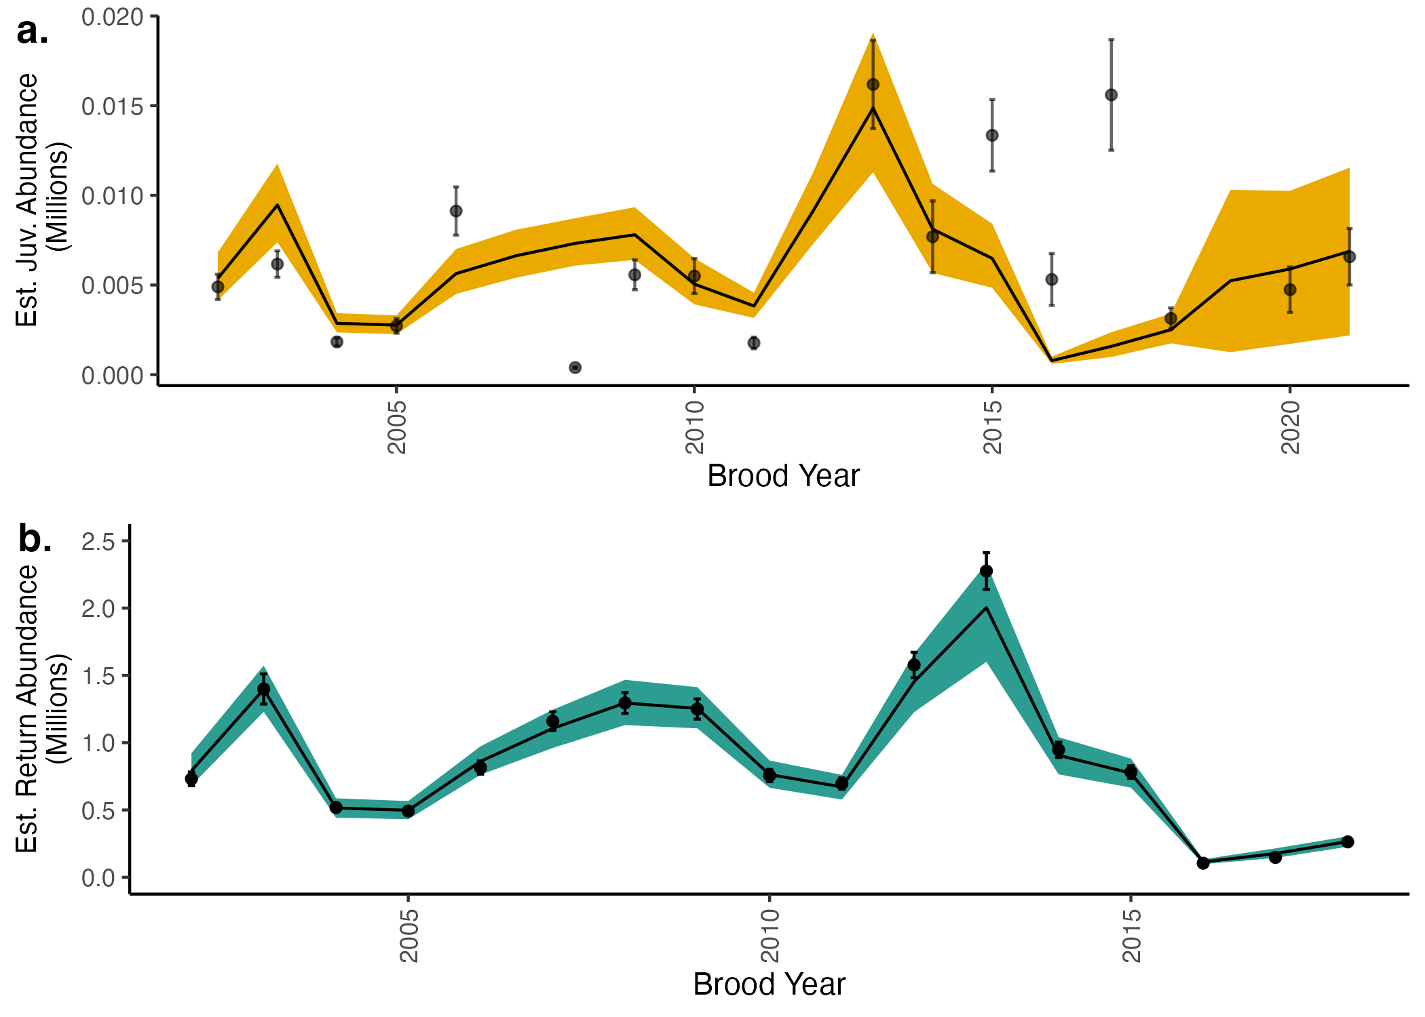
Notes:
Figure 3: Time series of indices used in the model likelihood inputs and model fits.
Points represent juvenile (a) and returning fish (b) indices used in the model likelihood while the lines represent the mean from estimated posterior distributions. Colored bands represent 95% credible intervals. The x axis represents the brood year, or the year when fish are in the egg stage. The NBS survey used to estimate the juvenile index did not occur in 2020 due to the global pandemic, so there is no juvenile index for brood year 2019.

Slide 5
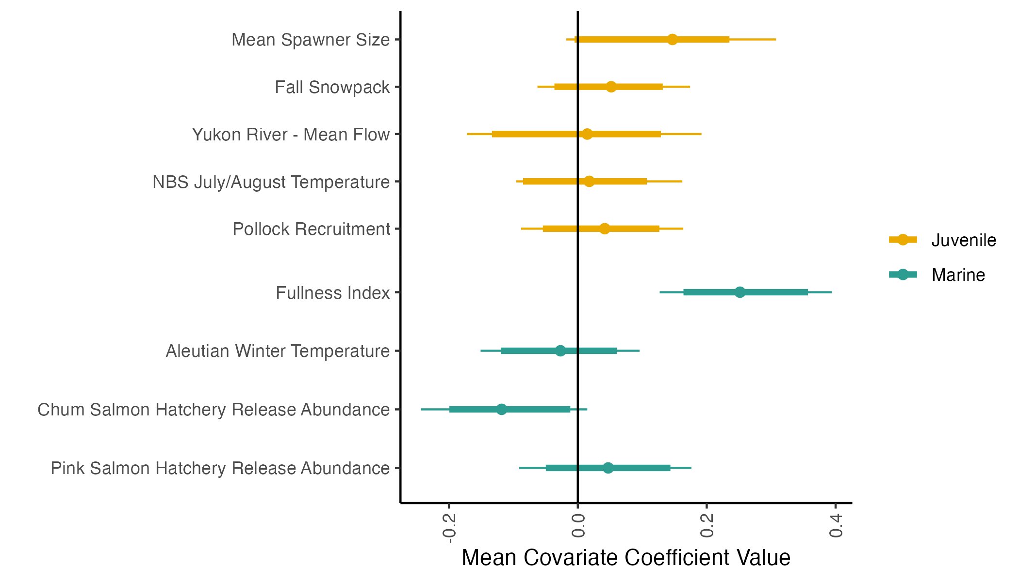
Notes:
Figure 4: Mean estimates of covariate coefficients. Colors represent the life-stage where survival is estimated, informed by the respective covariate. Points represent mean estimates, thick lines represent 89% credible intervals and thin lines represent 95% credible intervals.

Slide 6
Supplementary Figures

Slide 7
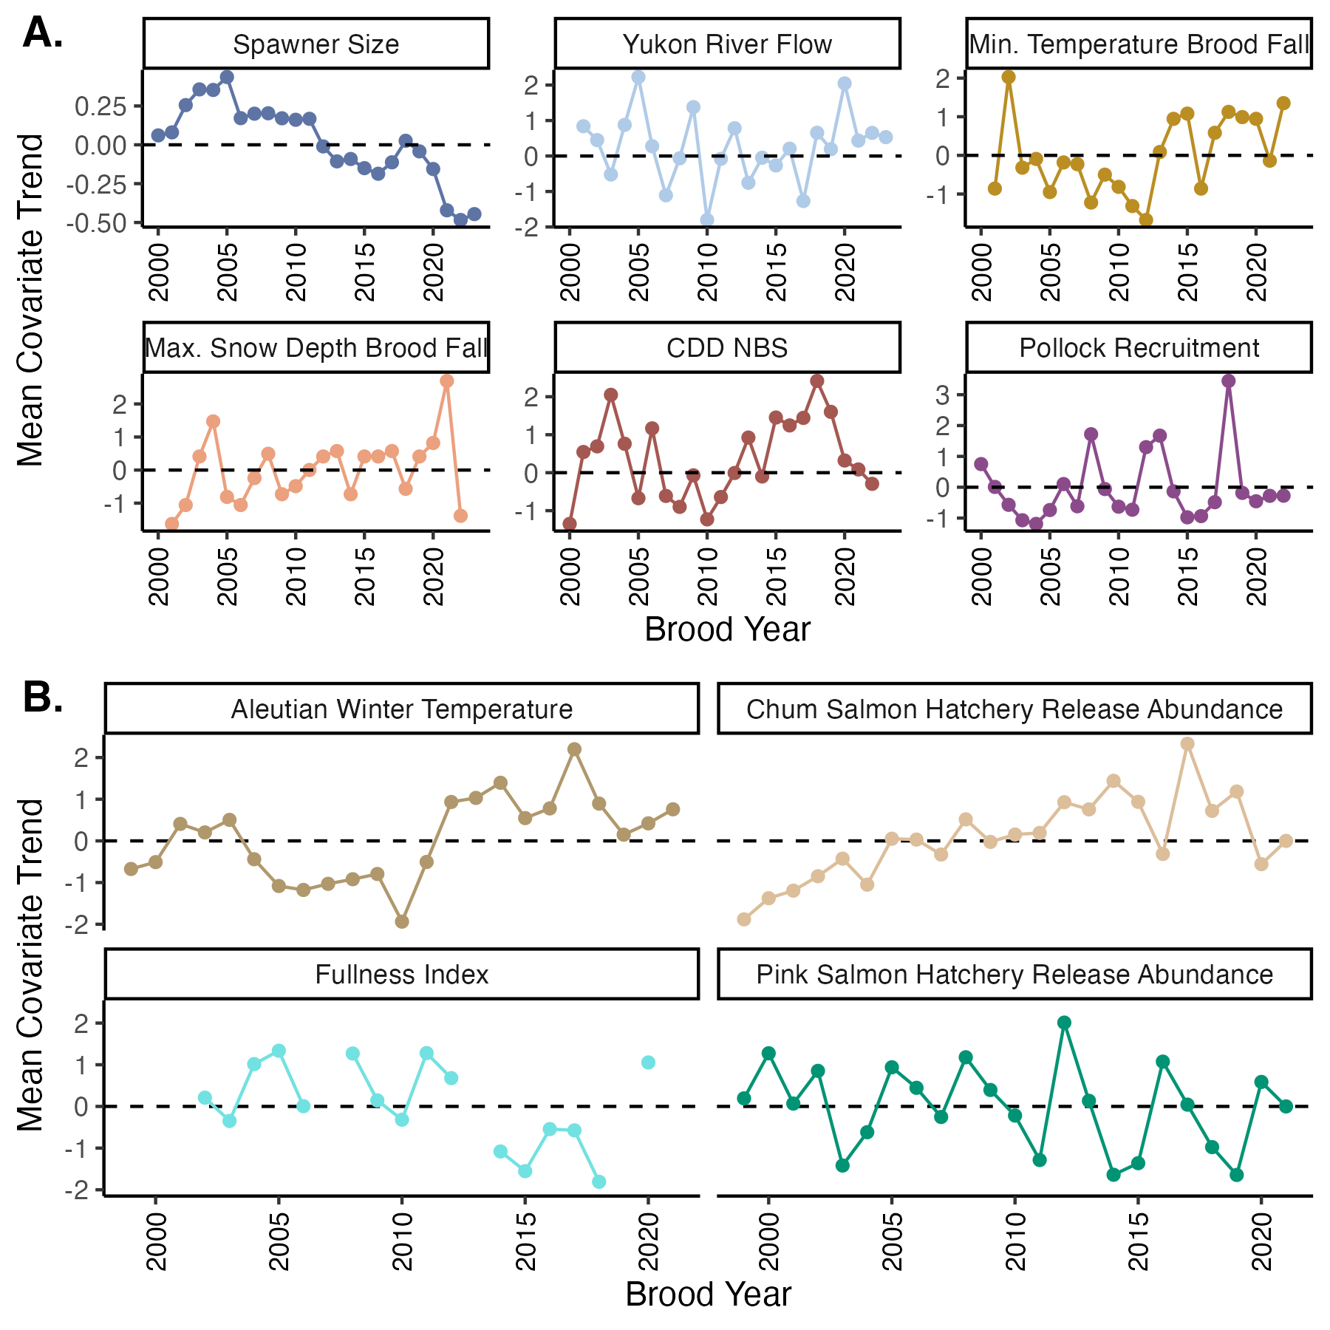
Notes:
Figure S1:
Mean-scaled covariate trends used in the IPM for the a) juvenile (egg to first summer at sea) and b) marine (first summer at sea to end of first winter at sea) stages.

Slide 8
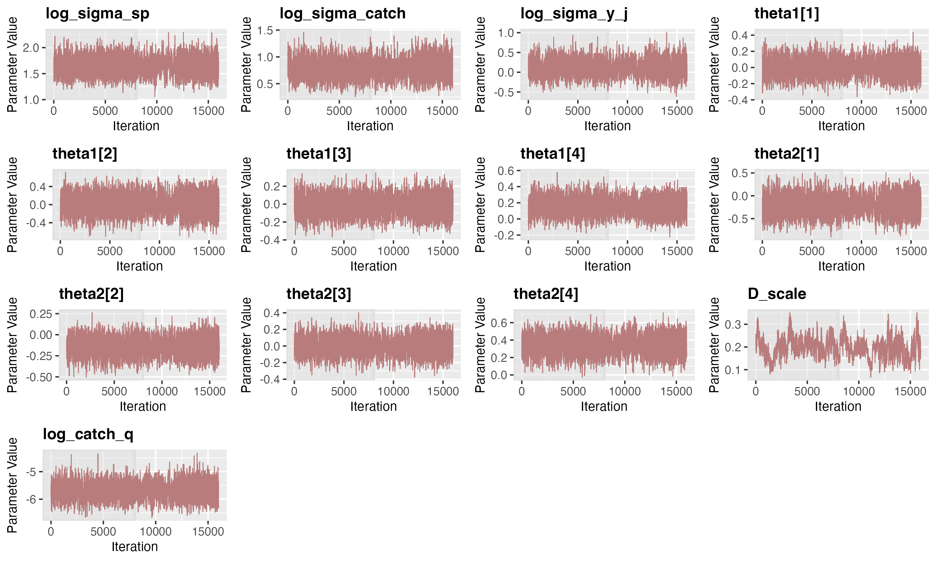
Notes:
Figure S2 – Trace plots used to identify model convergence for each for parameters. Four chains were run per model, dark shading represents burn-in iterations.

Slide 9
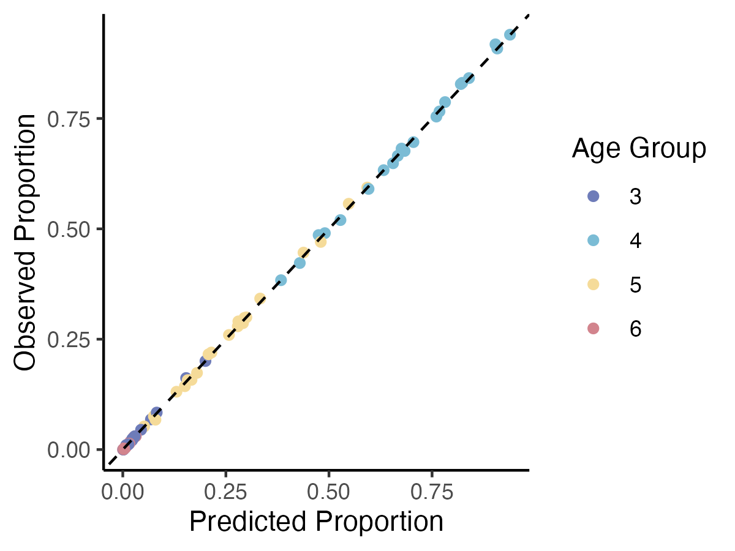
Notes:
Figure S3: Comparison of model predicted and observed age compositions, where each age represents a comparison for each calendar year and age class (ocean age). The dashed line represents a 1:1 comparison line, points that fall on the line are equal.

Slide 10
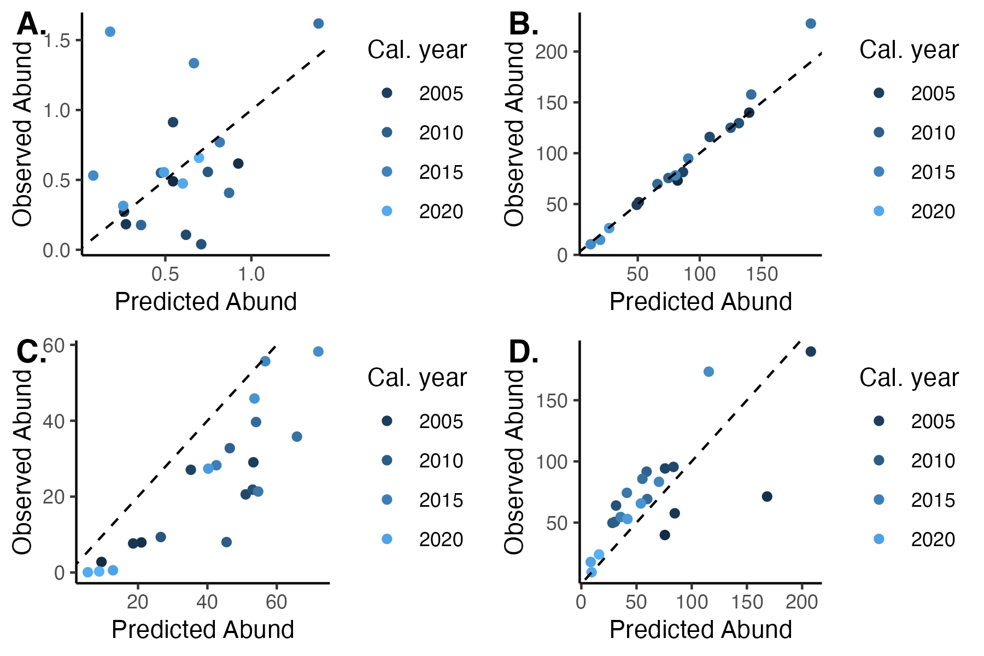
Notes:
Figure S4: Comparison of model predicted and observed abundances for a) Juveniles b) total returns c) harvest, d) spawner abundances. Each point represents a comparison for each calendar year and abundance.The dashed line represents a 1:1 comparison line, points that fall on the line are equal.
UPDATE THIS PLOT -----

Slide 11
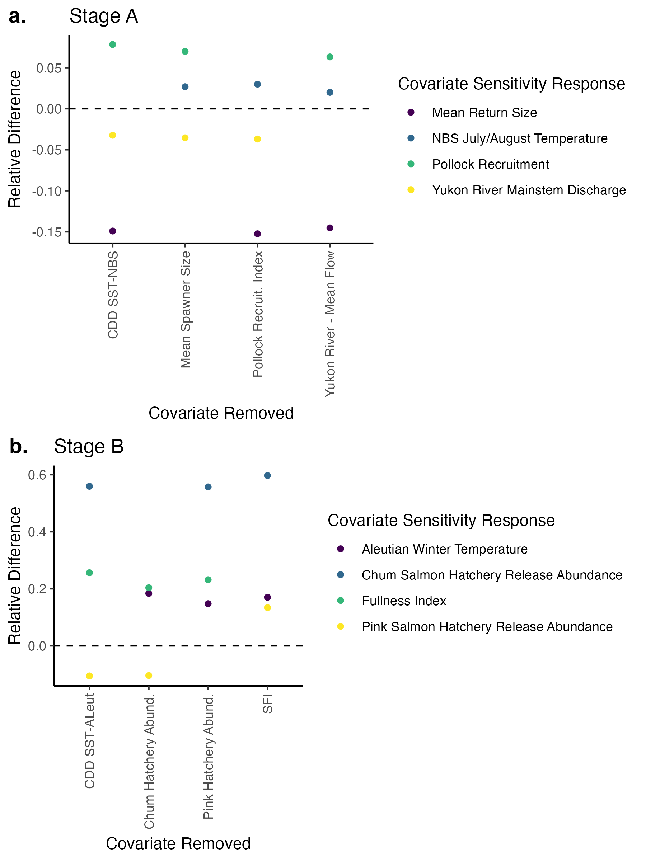
Notes:
Figure S5:
Results from covariate sensitivity testing. We calculated percent relative difference in covariate coefficients from the full model compared to a reduced model where one covariate removed at a time (covariate removed identified on x axis).

Slide 12
Older figure versions

Slide 13
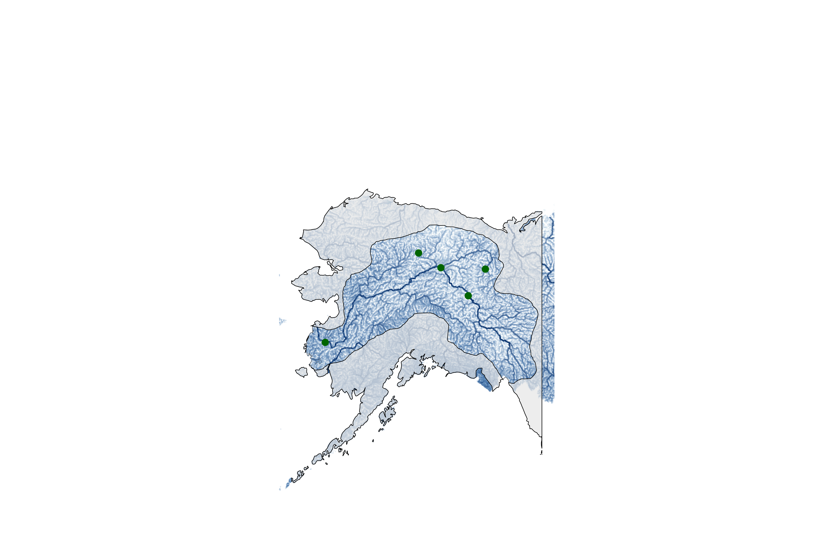
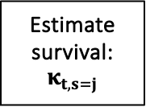
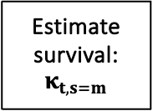
1.N_{t,s=e}: Eggs
Fall Chum Integrated Population Model Structure
Estimate survival: $κ_{t,s=j}$
2. N_{t+1,s=j}: Abundance after first summer at sea (August/Sept)
Juvenile Index from Northern Bering Sea surveys
(Data: NOAA/ADFG, Modeled Index: Cunningham et al.)
Fish migrate to the E. Aleutians & Gulf of Alaska (GOA) for their first winter, and subsequent maturation.
5. N_{t+a+1,s=s,a}: Spawning abundance
Data: ADFG, Fleischman & Borba 2009
Estimate survival: $κ_{t, s=m}$
4. N_{t+a+1,s=h,a}: Harvest abundance
Data: ADFG, Fleischman & Borba 2009
3. N_{t+a+1,s=m,a}: Returning fish abundance
Data: ADFG, Fleischman & Borba 2009
Notes:
Figure 1: Conceptual model describing the main steps in the fall Chum integrated population model. Blue stars indicate that fish move to the E. Aleutians and GOA for their first winter and subsequent maturation. Each numbered step represents a population stages that is tracked in the IPM. Stages in orange represent stages where the model estimations are included in the likelihood. After the spawning abundance stage, the model starts over again at stage 1, the egg stage. Note that location of each stage does not reflect the location of individuals at any particular stage. The map on the right-hand side of the figure includes Alaska, USA, and western Canada. The mask is highlighting the Yukon River watershed and associated tributaries. The mainstem of the Yukon River is the most prominent dark blue line and the green dots represent escapement project locations that were used as data in the Fall chum salmon run reconstruction.

Slide 14
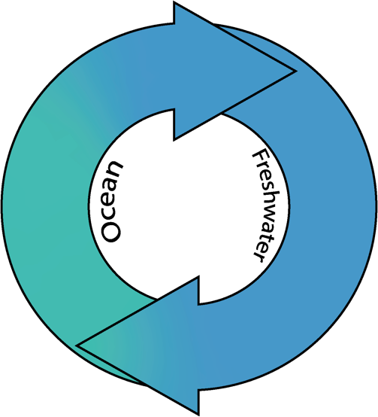
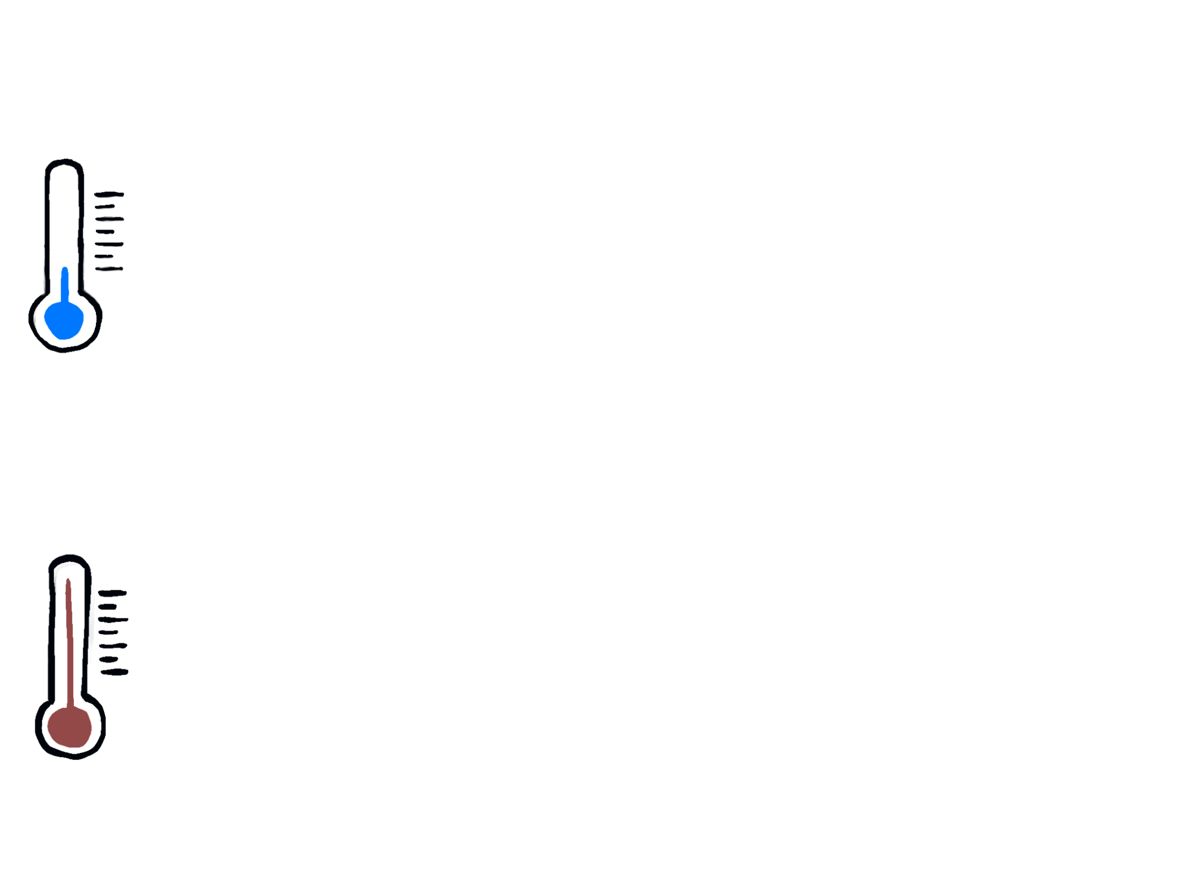
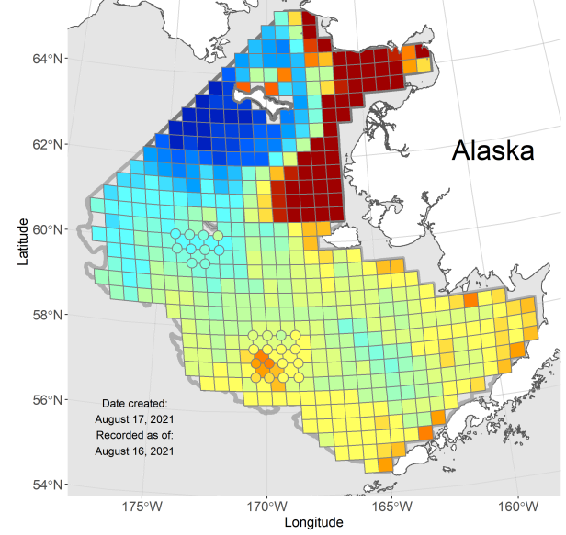
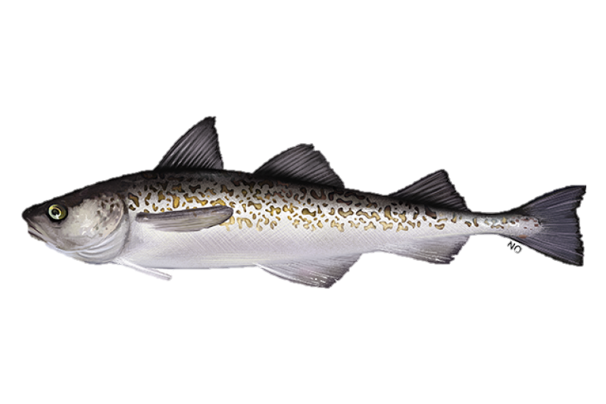
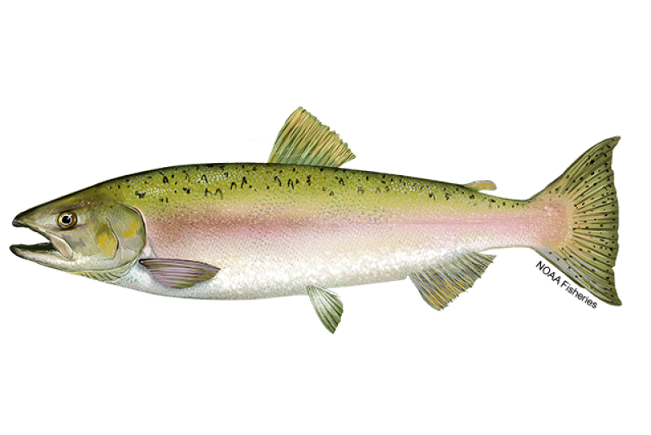
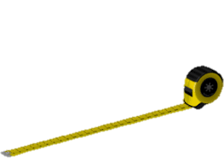
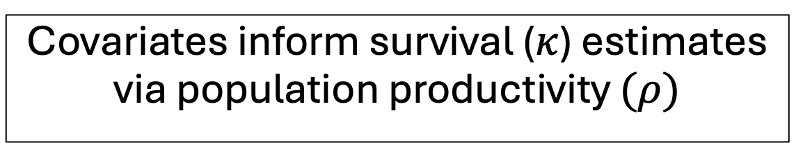
Covariates inform survival ($κ$) estimates via population productivity $(ρ)$
1.Yukon river mainstem flow rate (Pilot Station)
- Data: USGS
8. Aleutian Cumulative Degree Days during 1st winter
(Data: AKFIN, NOAA)
2. N Bering Sea Summer Cumulative Degree Days
- Data: AKFIN, NOAA
7. “Juvenile fullness index”
(Estimated from NBS surveys, data: NOAA & ADFG).
Marine Survival
Juvenile Survival
3. Pollock Recruitment Index
- Ianelli et al 2024
6. Pink hatchery salmon abundance
5. Chum hatchery salmon abundance
(Data: NPAFC)
4. Mean Spawner Size
- ADFG
5. Gelatinous zooplankton may provide lower quality prey (Cook & Sturdevant 2013).
Notes:
Figure 2: Covariates used to estimate chum salmon population productivity for two life stages. Data sources listed below the covariate and more covariate details are listed in Table 2.

Slide 15
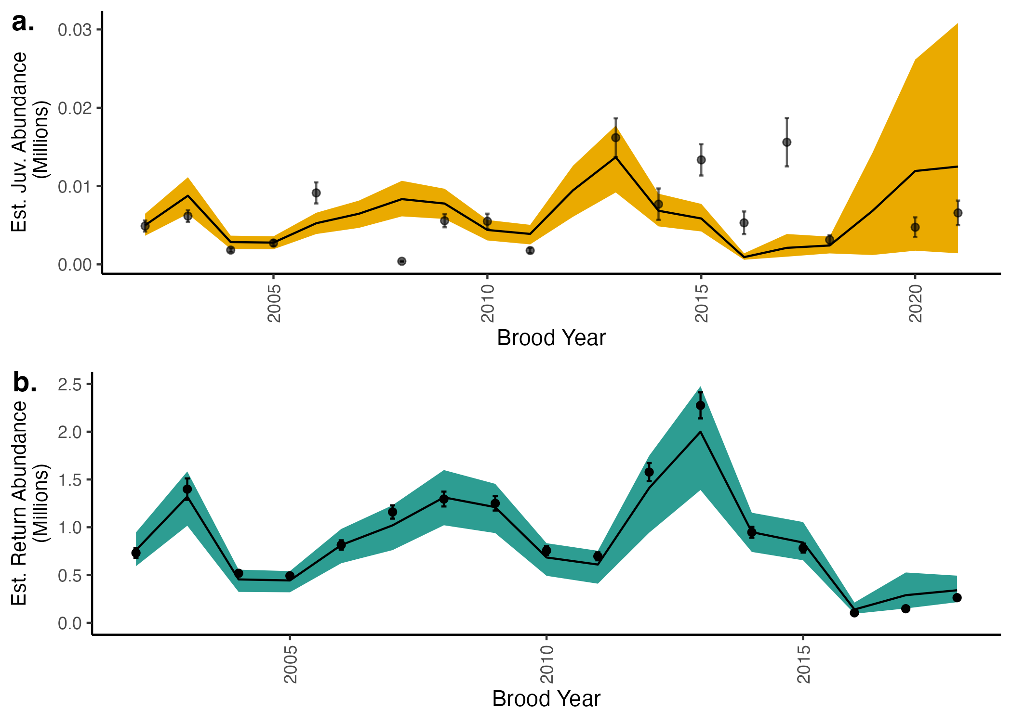
Notes:
Figure 3: Time series of indices used in the model likelihood inputs and model fits.
Points represent juvenile (a) and returning fish (b) indices used in the model likelihood while the lines represent the mean from estimated posterior distributions. Colored bands represent 95% credible intervals. The x axis represents the brood year, or the year when fish are in the egg stage. The NBS survey used to estimate the juvenile index did not occur in 2020 due to the global pandemic, so there is no juvenile index for brood year 2019.

Slide 16
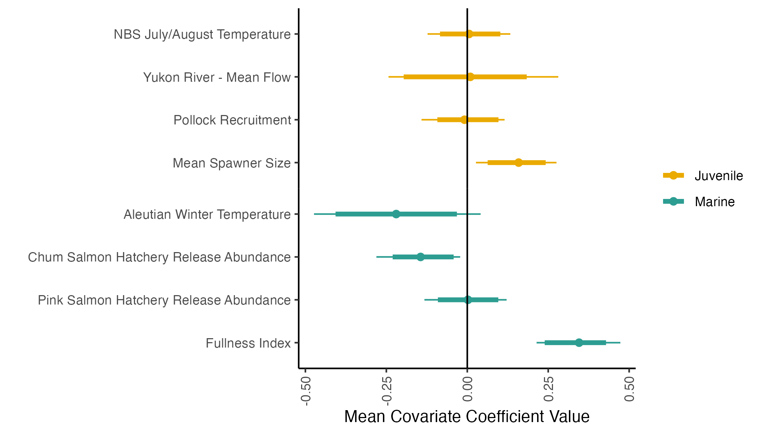
Notes:
Figure 4: Mean estimates of covariate coefficients. Colors represent the life-stage where survival is estimated, informed by the respective covariate. Points represent mean estimates, thick lines represent 89% credible intervals and thin lines represent 95% credible intervals.

